Slide 1
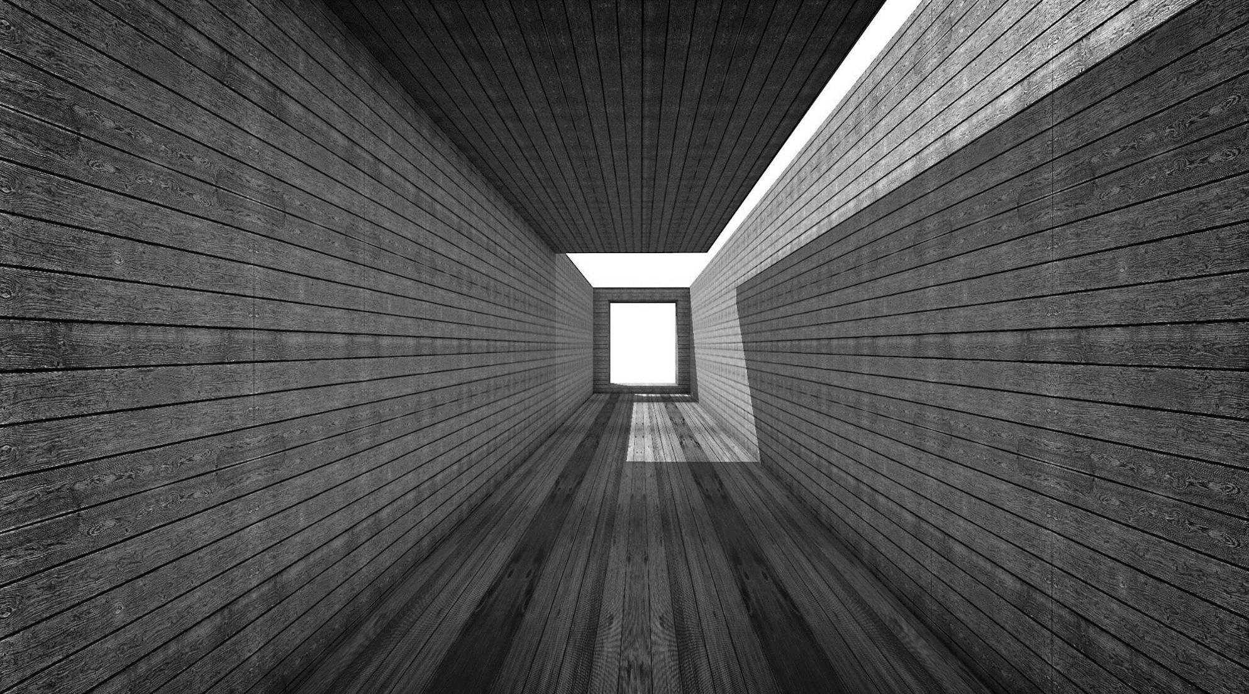
Attendance system by Face Recognition (Based on python using machine learning)
Group member:-
Raunaq Vaid (02491102018)
Nidhi Verma (41391102018
BCA 6C(EVENING)

Slide 2

Index
S no. | Title
1) | Introduction
2) | Aim and objectives
3) | Use case diagram
4) | DFD level 0 diagram
5) | DFD level 1 diagram
6) | ER diagram
7) | H/W and S/W requirements
8) | Database tables
9) | Screenshots
10) | Conclusion
11) | Future scope
12) | Bibliography/References

Slide 3


Introduction
This project introduces an involuntary attendance marking system, devoid of
any kind of interference with the normal teaching procedure. The system can be also implemented during exam sessions or in other teaching activities where attendance is highly essential.
This system eliminates classical student identification such as calling name of the student, or checking respective identification cards of the student, which can not only interfere with the ongoing teaching process, but also can be stressful for students during examination sessions. In addition, the students have to register in the database to be recognized.
As we are making a system which can recognize face and match with its own database. It will make the attendance system more authentic.

Slide 4
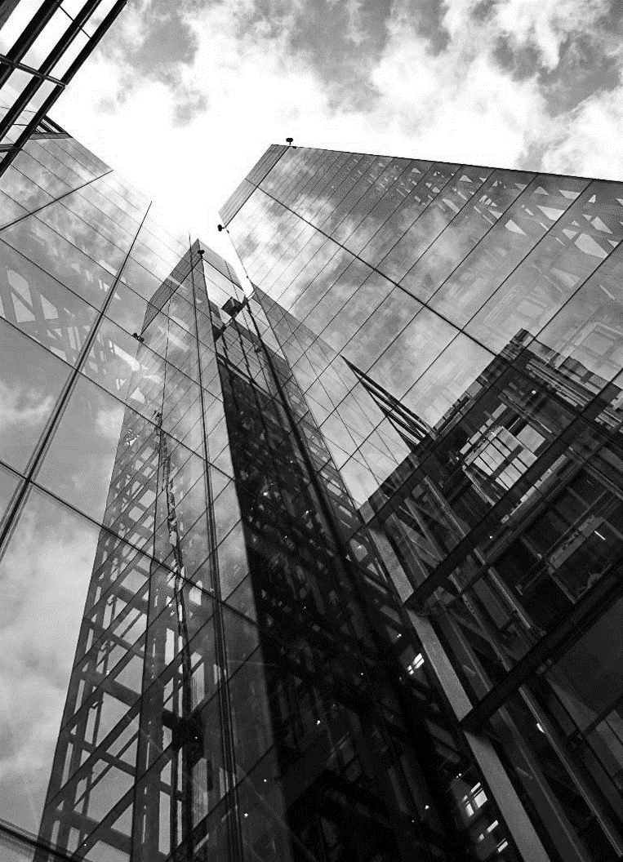




Aims and Objectives
The aim of this project is to develop face recognition attendance system. Expected objectives in order to fulfill the aims are:
Detect
Extract
To detect the face segment from the video frame.
To extract the useful features from the face detected.
Classify
Record
To classify the features in order to recognize the face detected.
To record the attendance of the identified student.

Slide 5

Use Case diagram
Registration
Take
Picture
Save
Take Attendance
View
Admin
User
Quit

Slide 6
Data flow diagram (level 0)
User
Admin
Attendance system by face recognition
Registration
Student Details
Take Images
Save profile
Attendance Report
Take Attendance
Quit

Slide 7
Data flow diagram (level 1)
User
Admin
Image Database
Does the student already
Exist?
No
Yes
Student
registration
Take
Attendance
Student Details
Take Images
Attendance
marked
Save
Profile
Attendance
Quit

Slide 8
Entity Relationship Diagram
Name
Id
Id
Time
Gives
Student
M
M
Attendance
1
Id
Name
Register
Id
Date
1
Image
Name

Slide 9
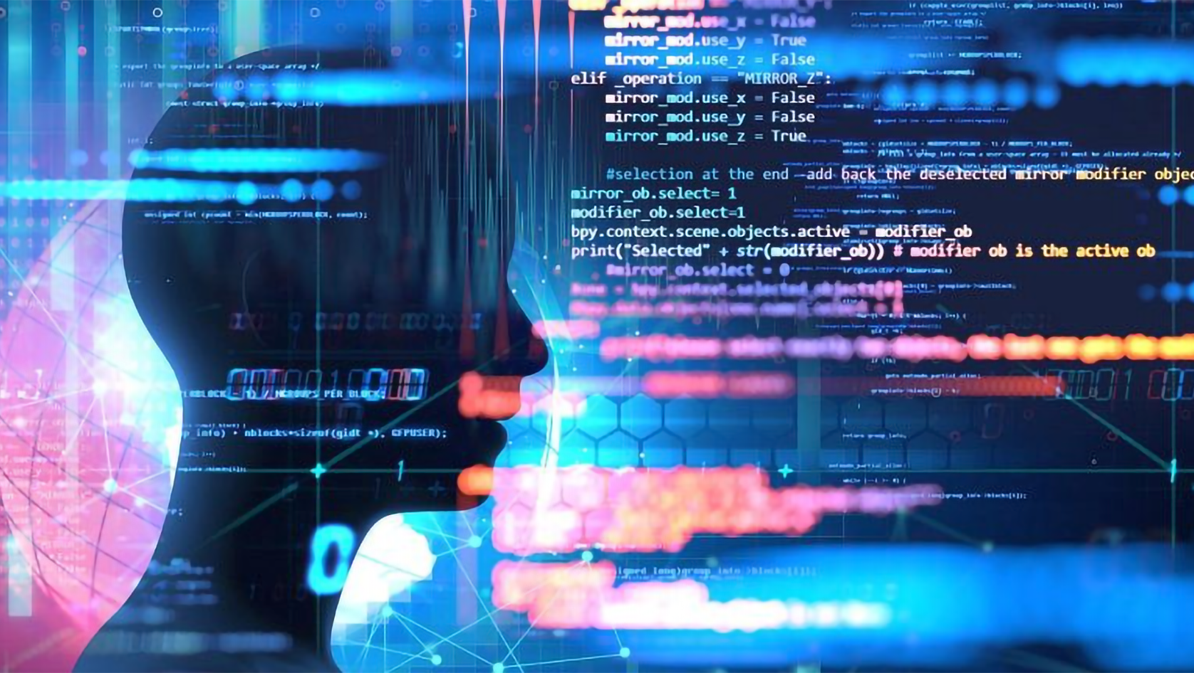
Hardware and Software Used
Hardware:
Laptop/desktop
Webcam
Software:
Spyder version 4.0.1/Pycharm
Excel(.xlsx)

Slide 10


database tables
In our project all of the data is being stored in the .csv files. Our project consists of Two .csv files the very first one is named as “Studentdetails.csv”(fig1.0) which will be having two columns named as “id” and “name” , this .csv file will store the id and name of all the registered candidates/students. Second One is named as “Attendance_date_time.csv”(fig2.0) which will be having 4 columns named as “id”, “name”, “date” and “time”, this file will store the information of the recognized candidates by the program.
Fig1.0
Fig2.0

Slide 11
Screenshots

Slide 12
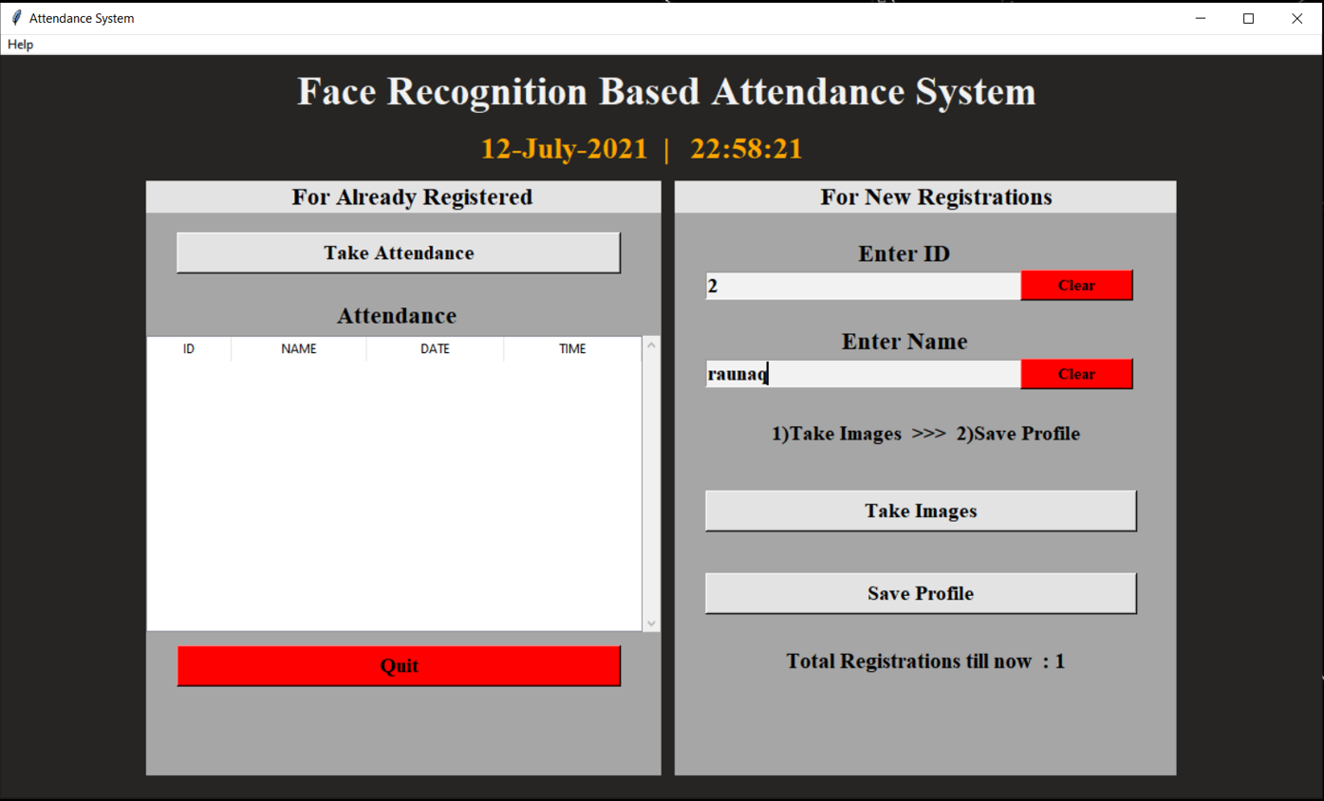
Fig 1.0

Slide 13
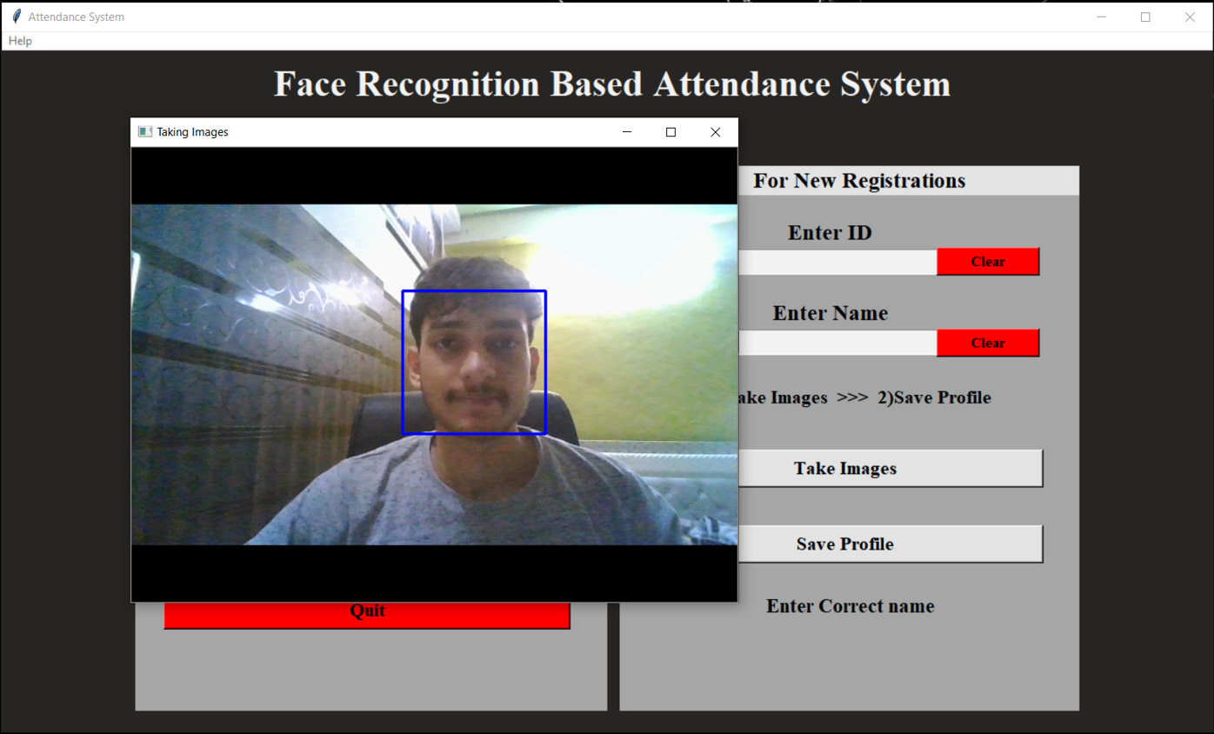
screenshots
Fig2.0

Slide 14
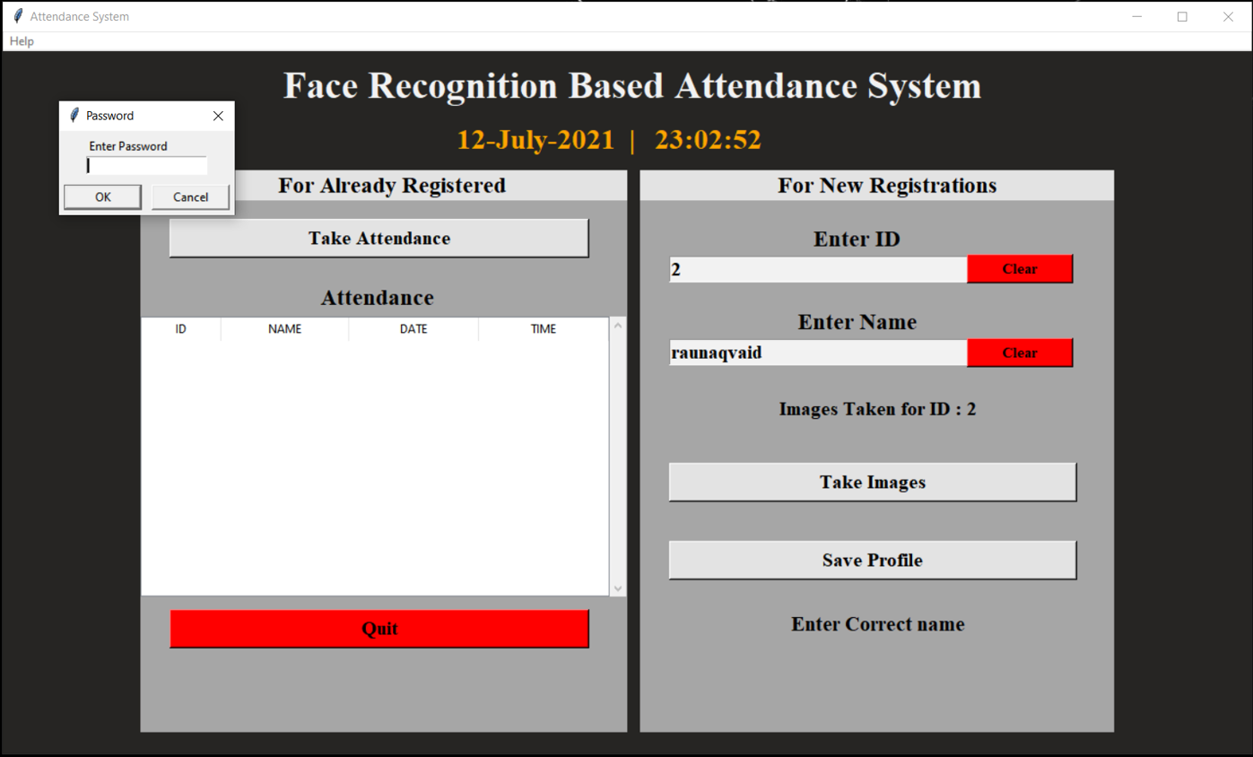
Fig3.0

Slide 15
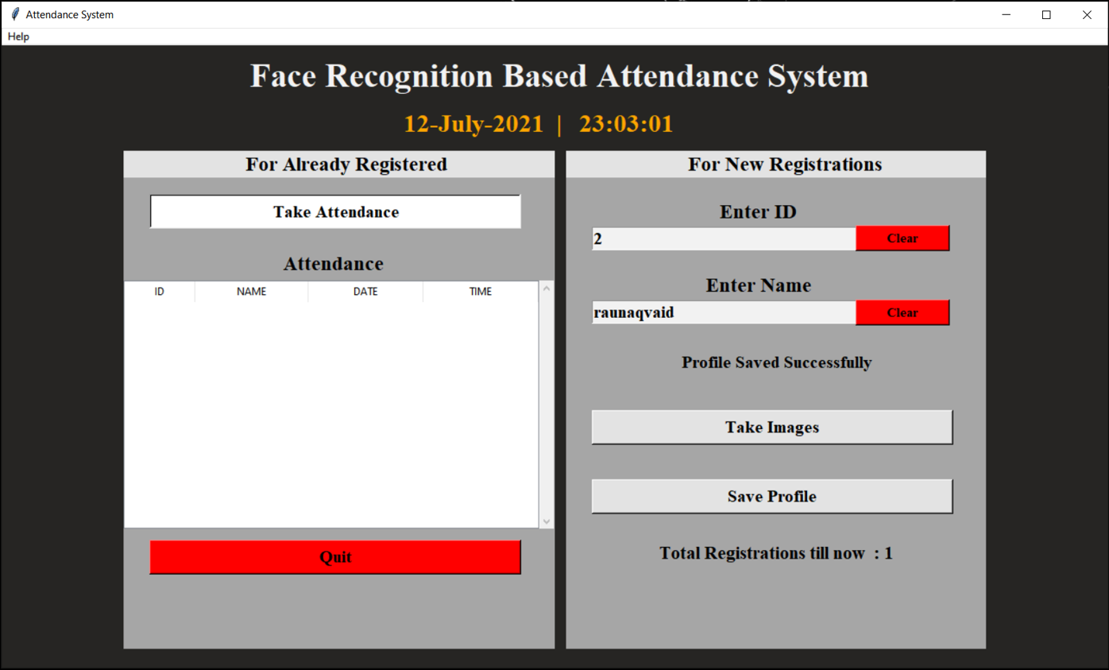
Fig4.0

Slide 16
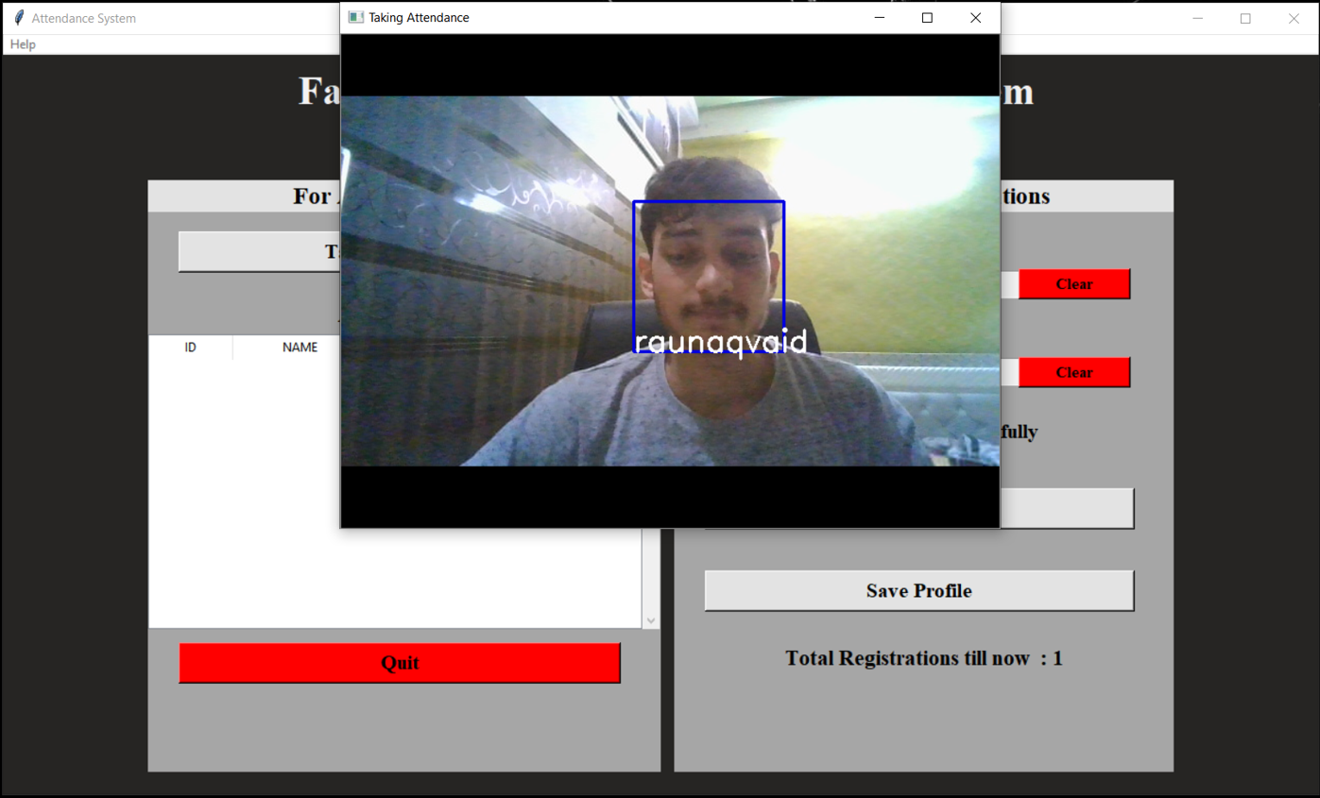
Fig5.0

Slide 17

Fig6.0

Slide 18
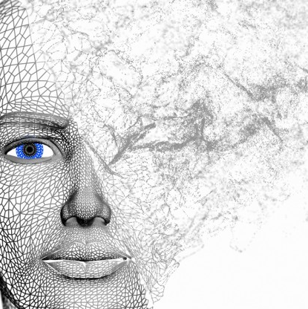
Conclusion
In this approach, a face recognition based automated student attendance system is thoroughly described. The proposed approach provides a method to identify the individuals by comparing their input image obtained from recording video frame with respect to train image. This proposed approach able to detect and localize face from an input facial image, which is obtained from the recording video frame. Besides, it provides a method in pre-processing stage to enhance the image contrast and reduce the illumination effect. Extraction of features from the facial image is performed by applying LBH algorithm. The accuracy of this proposed approach is somewhere around 81%.
This system eliminates classical student identification such as calling name of the student, or checking respective identification cards of the student,

Slide 19
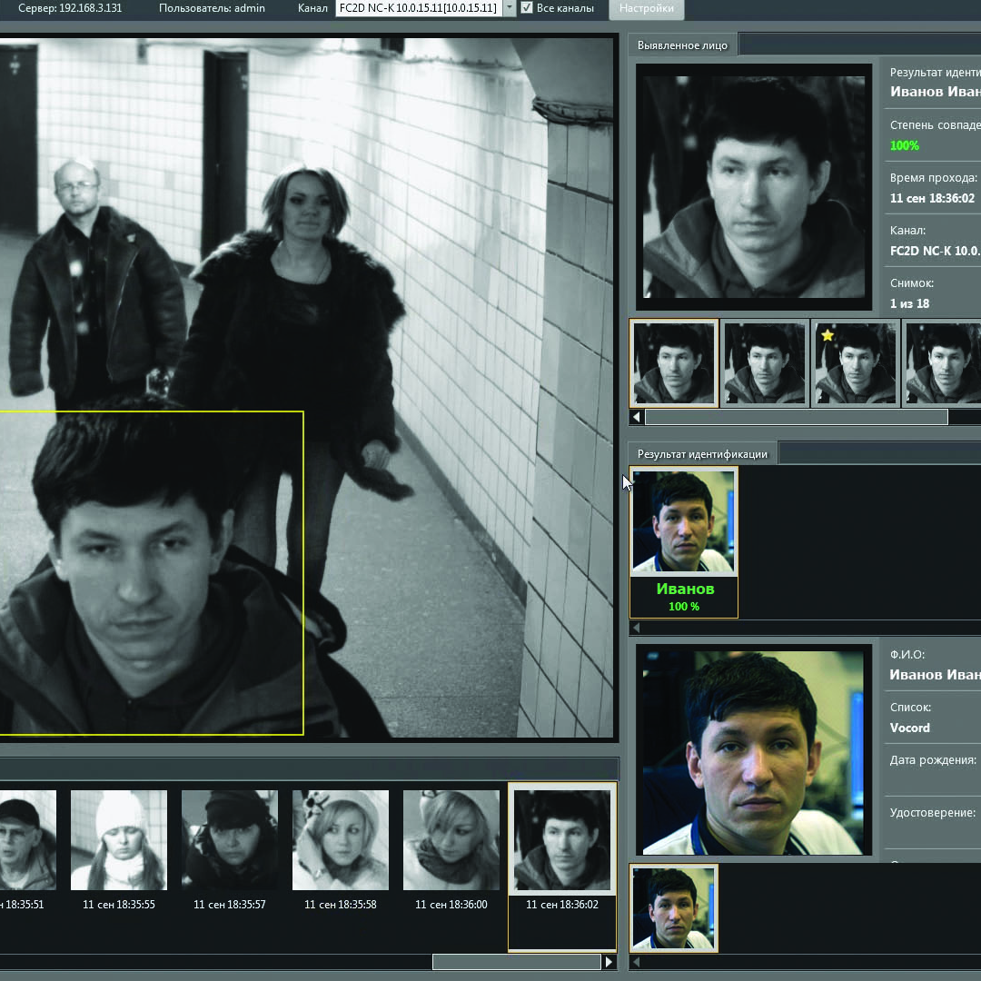
Future Scope
Face recognition provides non-intrusive way to recognize a person. By using this system, the chances of fake attendance and proxies can be eliminated.
Automated Attendance System can be implemented in larger areas like in a seminar hall where it helps in sensing the presence of many people.
Sometimes the poor lighting condition of the classroom may affect image quality which indirectly degrades system performance, this can be overcome in the latter stage by improving the quality of the video or by using some algorithms
As face provides a unique identity of a person, it can be used to identify a person and verify his/her identity.
19

Slide 20


Thank You
Raunaq Vaid (02491102018)
Nidhi Verma (41391102018)

